Slide 1


Deep Learning-Based Detection and Localization of Intracranial Hemorrhage Types
Team PixelMedics

Slide 2

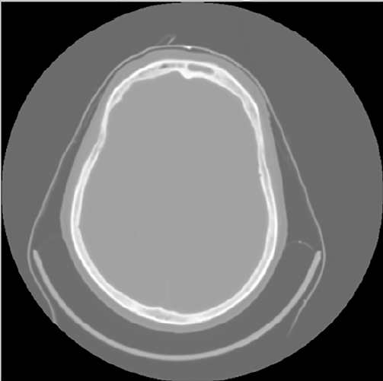
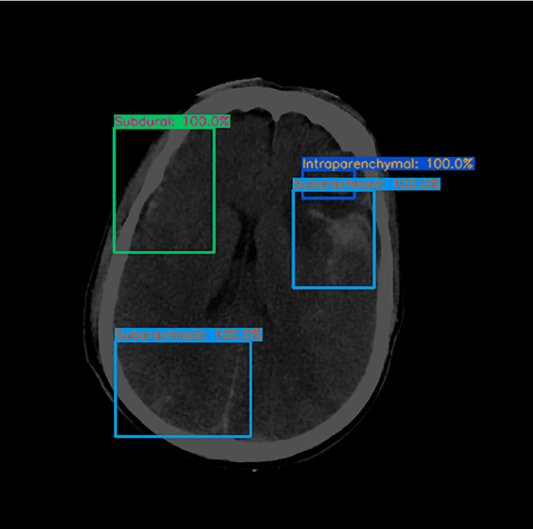

INTRODUCTION
Deep learning model
CT scan image
Annotated output
Notes:
Focusing on detecting and labeling brain hemorrhage by using CT scan images.
First, we pre-processed initial CT image to obtain details and the fed them to a deep neural network and trained it to give annotated output.

Slide 3
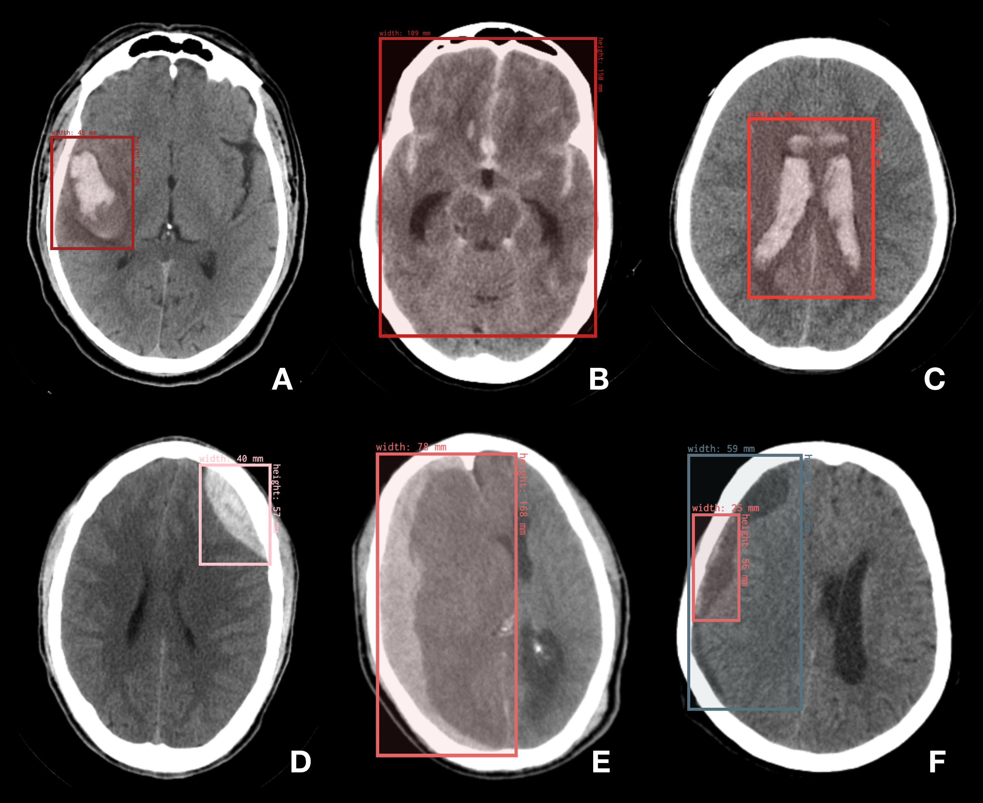
BHX Dataset
BHX contains up to 39,668 bounding boxes in 23,409 images annotated for hemorrhage, out of a total of ~170k images from qure.ai CQ500 dataset.
Version 1:
Initial_Manual_Labeling
Version2:
Extrapolation_to_All_Series
Version 3:
Extrapolation_to_Selected_Series
Notes:
Version 1 (file "1_Initial_Manual_Labeling.csv") contains only the hand-drawn annotations of the thick-slices.
Version 2 (file "2_Extrapolation_to_All_Series.csv") contains the thick-slices hand-drawn annotations as well as the extrapolation for all other corresponding images, regardless of whether they are bone filter or series with contrast.
Version 3 (file "3_Extrapolation_to_Selected_Series.csv") contains the thick-slices hand-drawn annotations as well as the extrapolation for the selected soft-tissue non-contrast-enhanced series only.

Slide 4
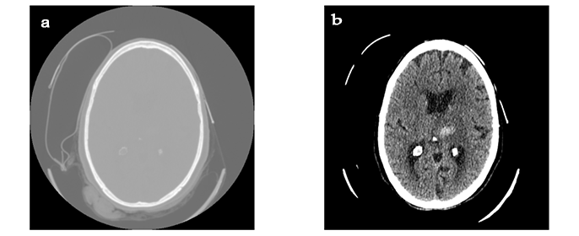
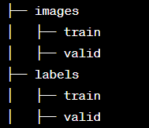
Data Pre-processing and Preparation
Pre-processing
Transformation to Hounsfield Unit (HU)
Windowing
Normalization
Morphology Dilation
Dimension Squeezing
Preparation
More than one bounding box in a scan image
Training and testing spitting
Organizing
Notes:
Hounsfield Units (HU) are a measure of radiodensity, often used in computed tomography (CT) scans.
Morphology dilation for remove unwanted noise particals
After dilation, the image might have an extra dimension, which can be unnecessary for further analysis.
Here we squeezed the image arrays from 3D to 2D.
Preparation, single image have mora than one label.

Slide 5

YOLOv8
State-of-the-art object detection algorithm that offers exceptional performance in terms of accuracy and speed.
Use in medical imaging analysis
Fine-tuned model to have 6 output classes
CIoU loss (Complete Intersection over Union) during training contributes to improved bounding box regression, leading to more accurate localization of objects.
Adam optimizer
350 epochs

Slide 6
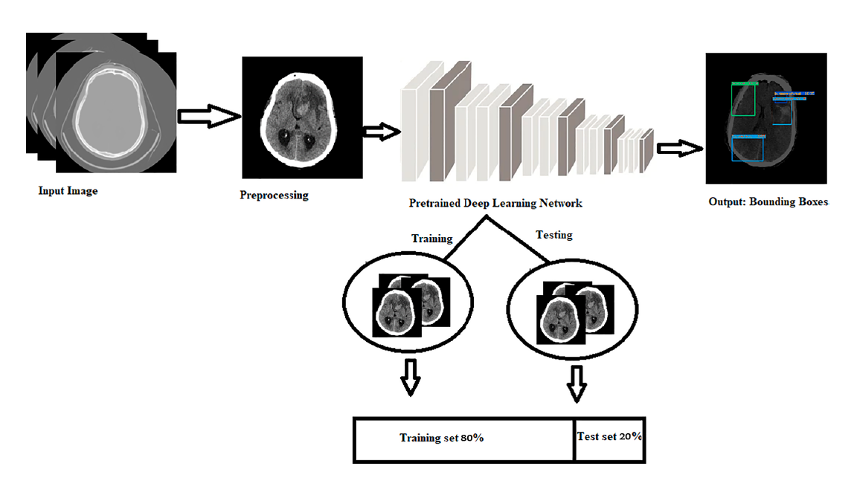
Overall Process
Notes:
Take input images labels
Pre-process the images and split them to training and testing
Take an annotated and hemorrhage localize image as the output

Slide 7
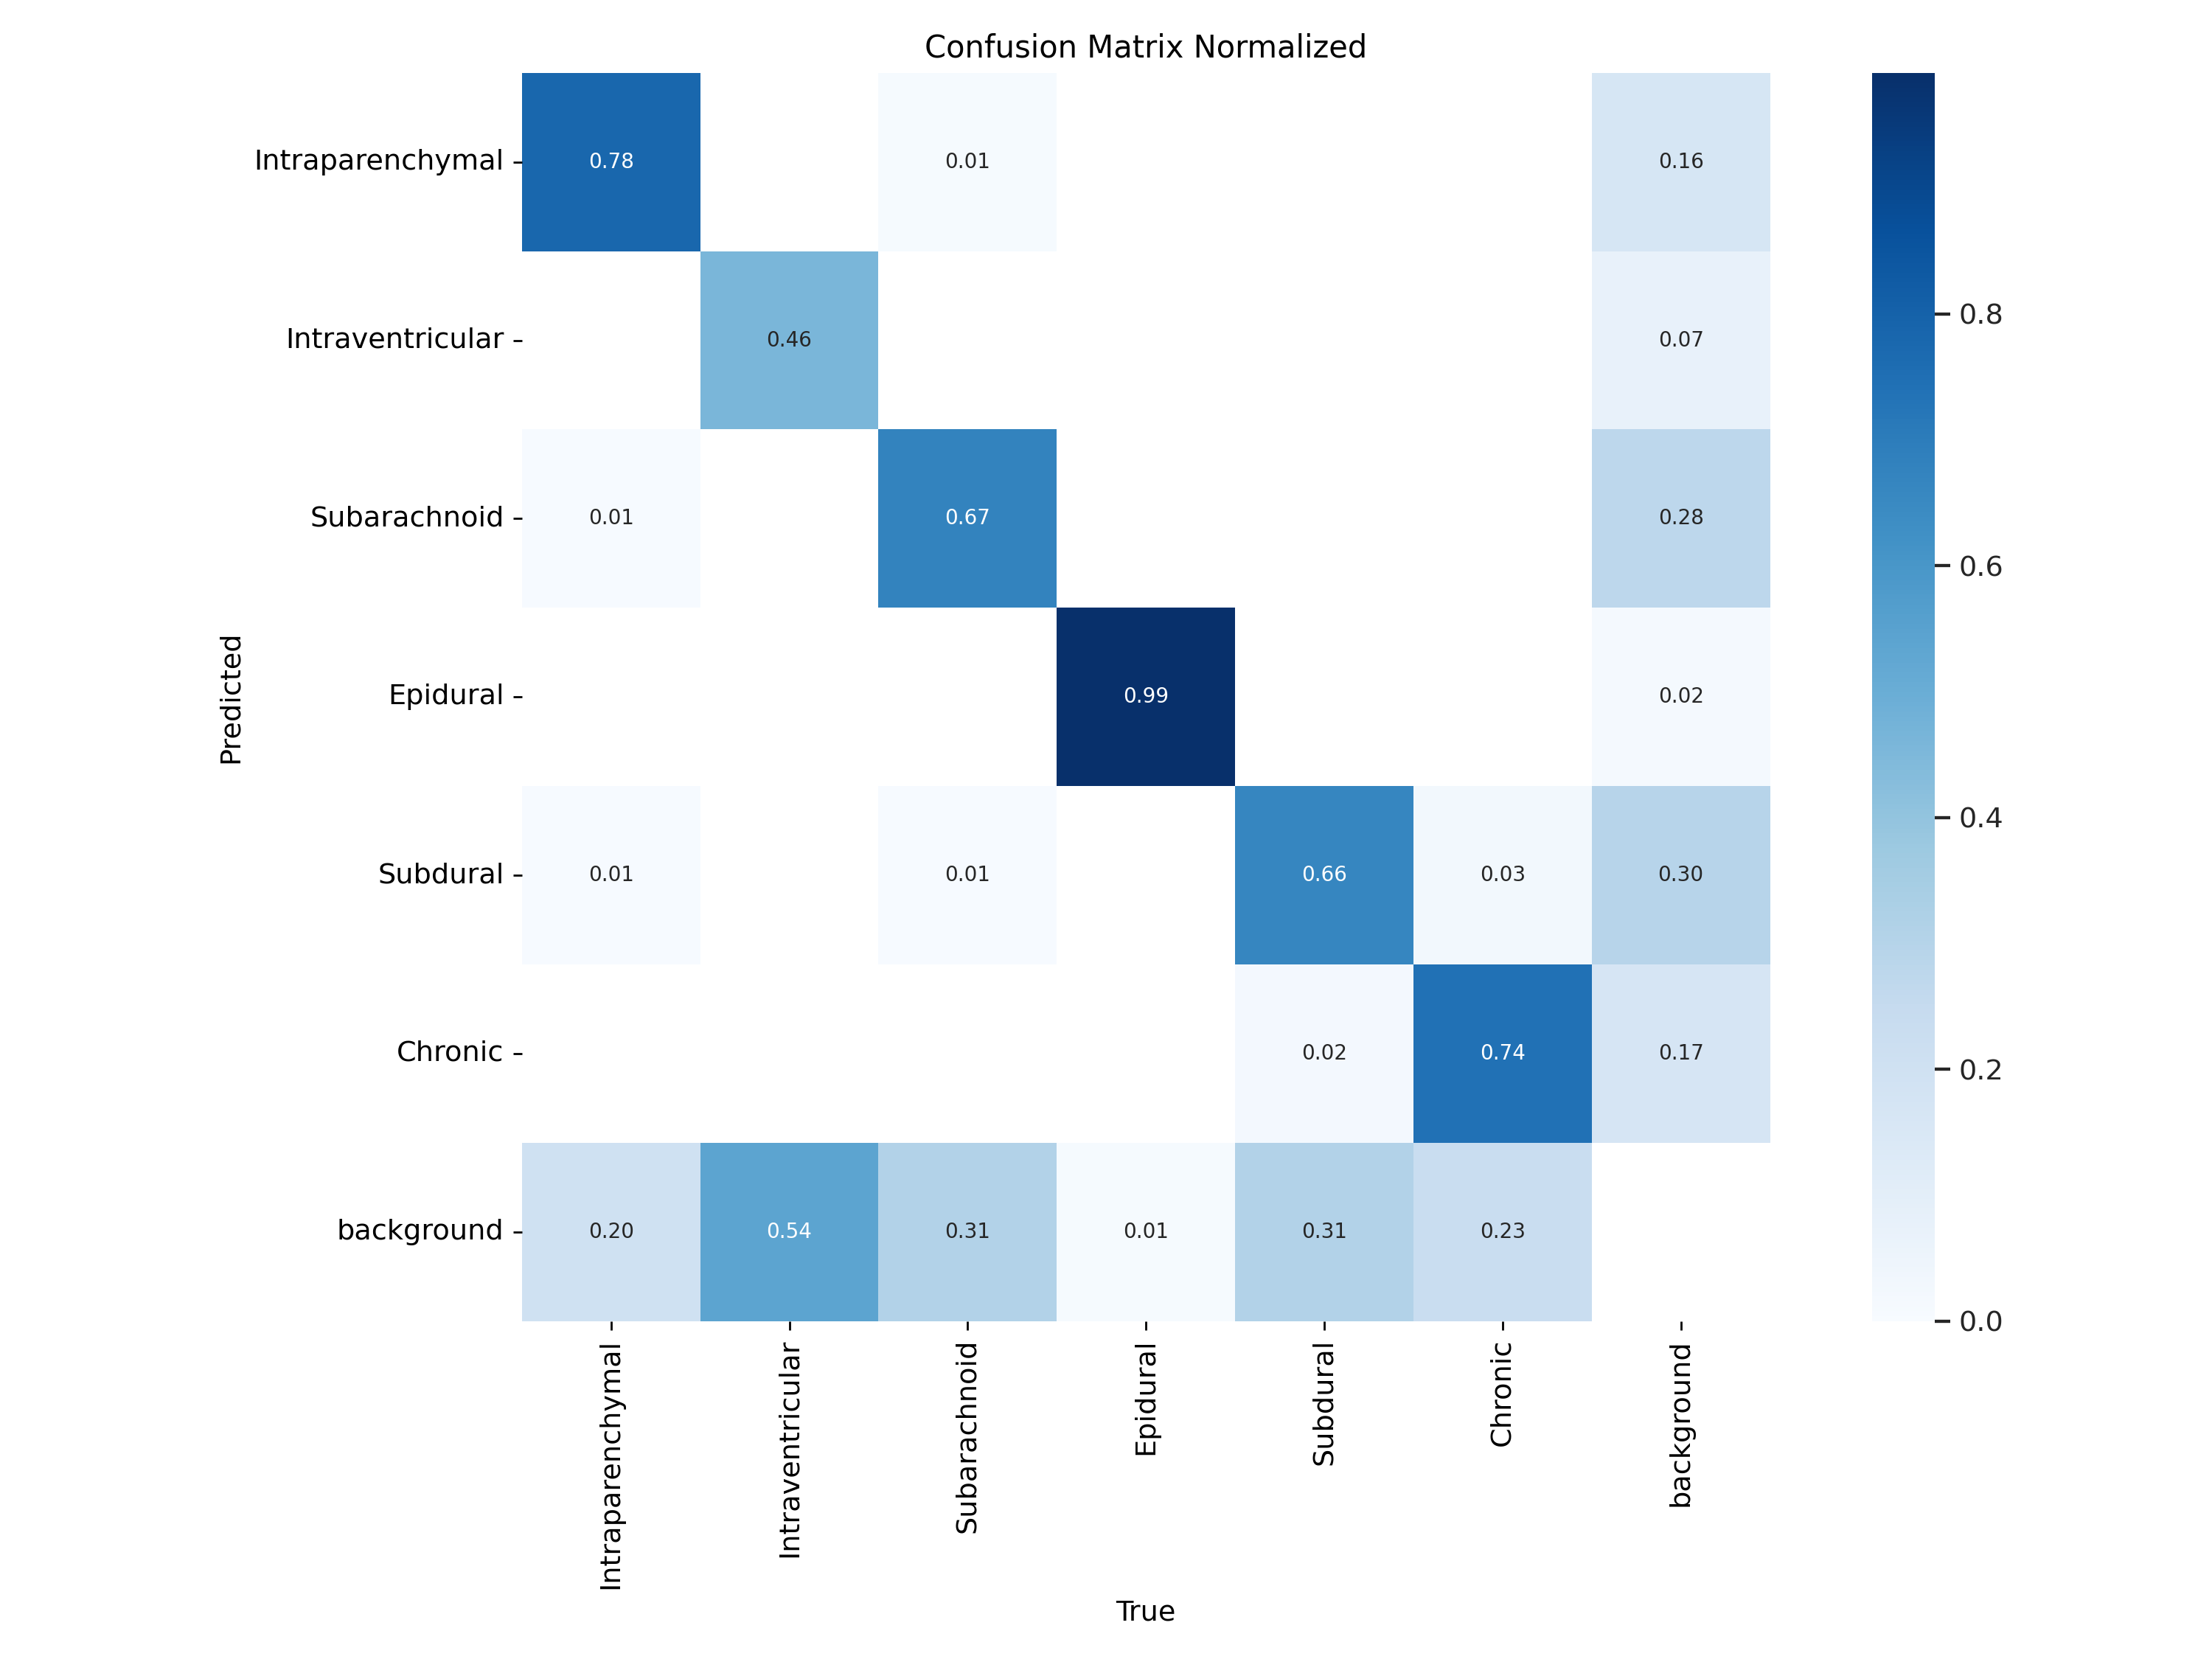
Results
Normalized confusion matrix
Notes:
Most of the classes have more than 50% accuracy.
But, of course we have to improve our model further to make this model as a good and trusted model.

Slide 8
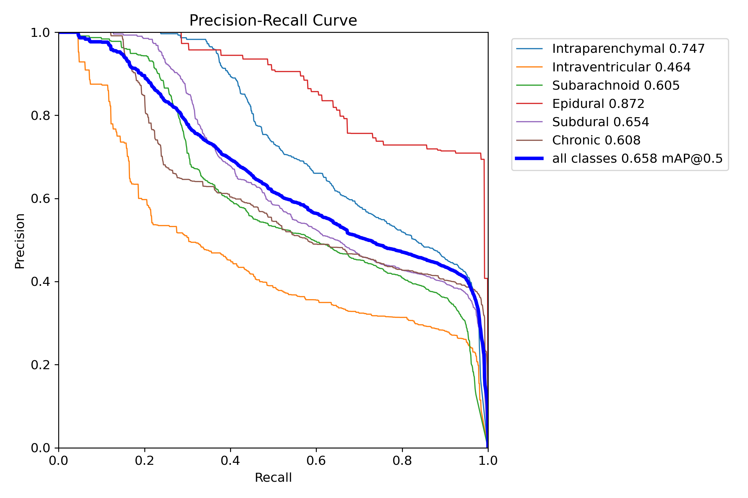
Precision vs. Recall curve
Notes:
This is the Precision vs. Recall cureve

Slide 9
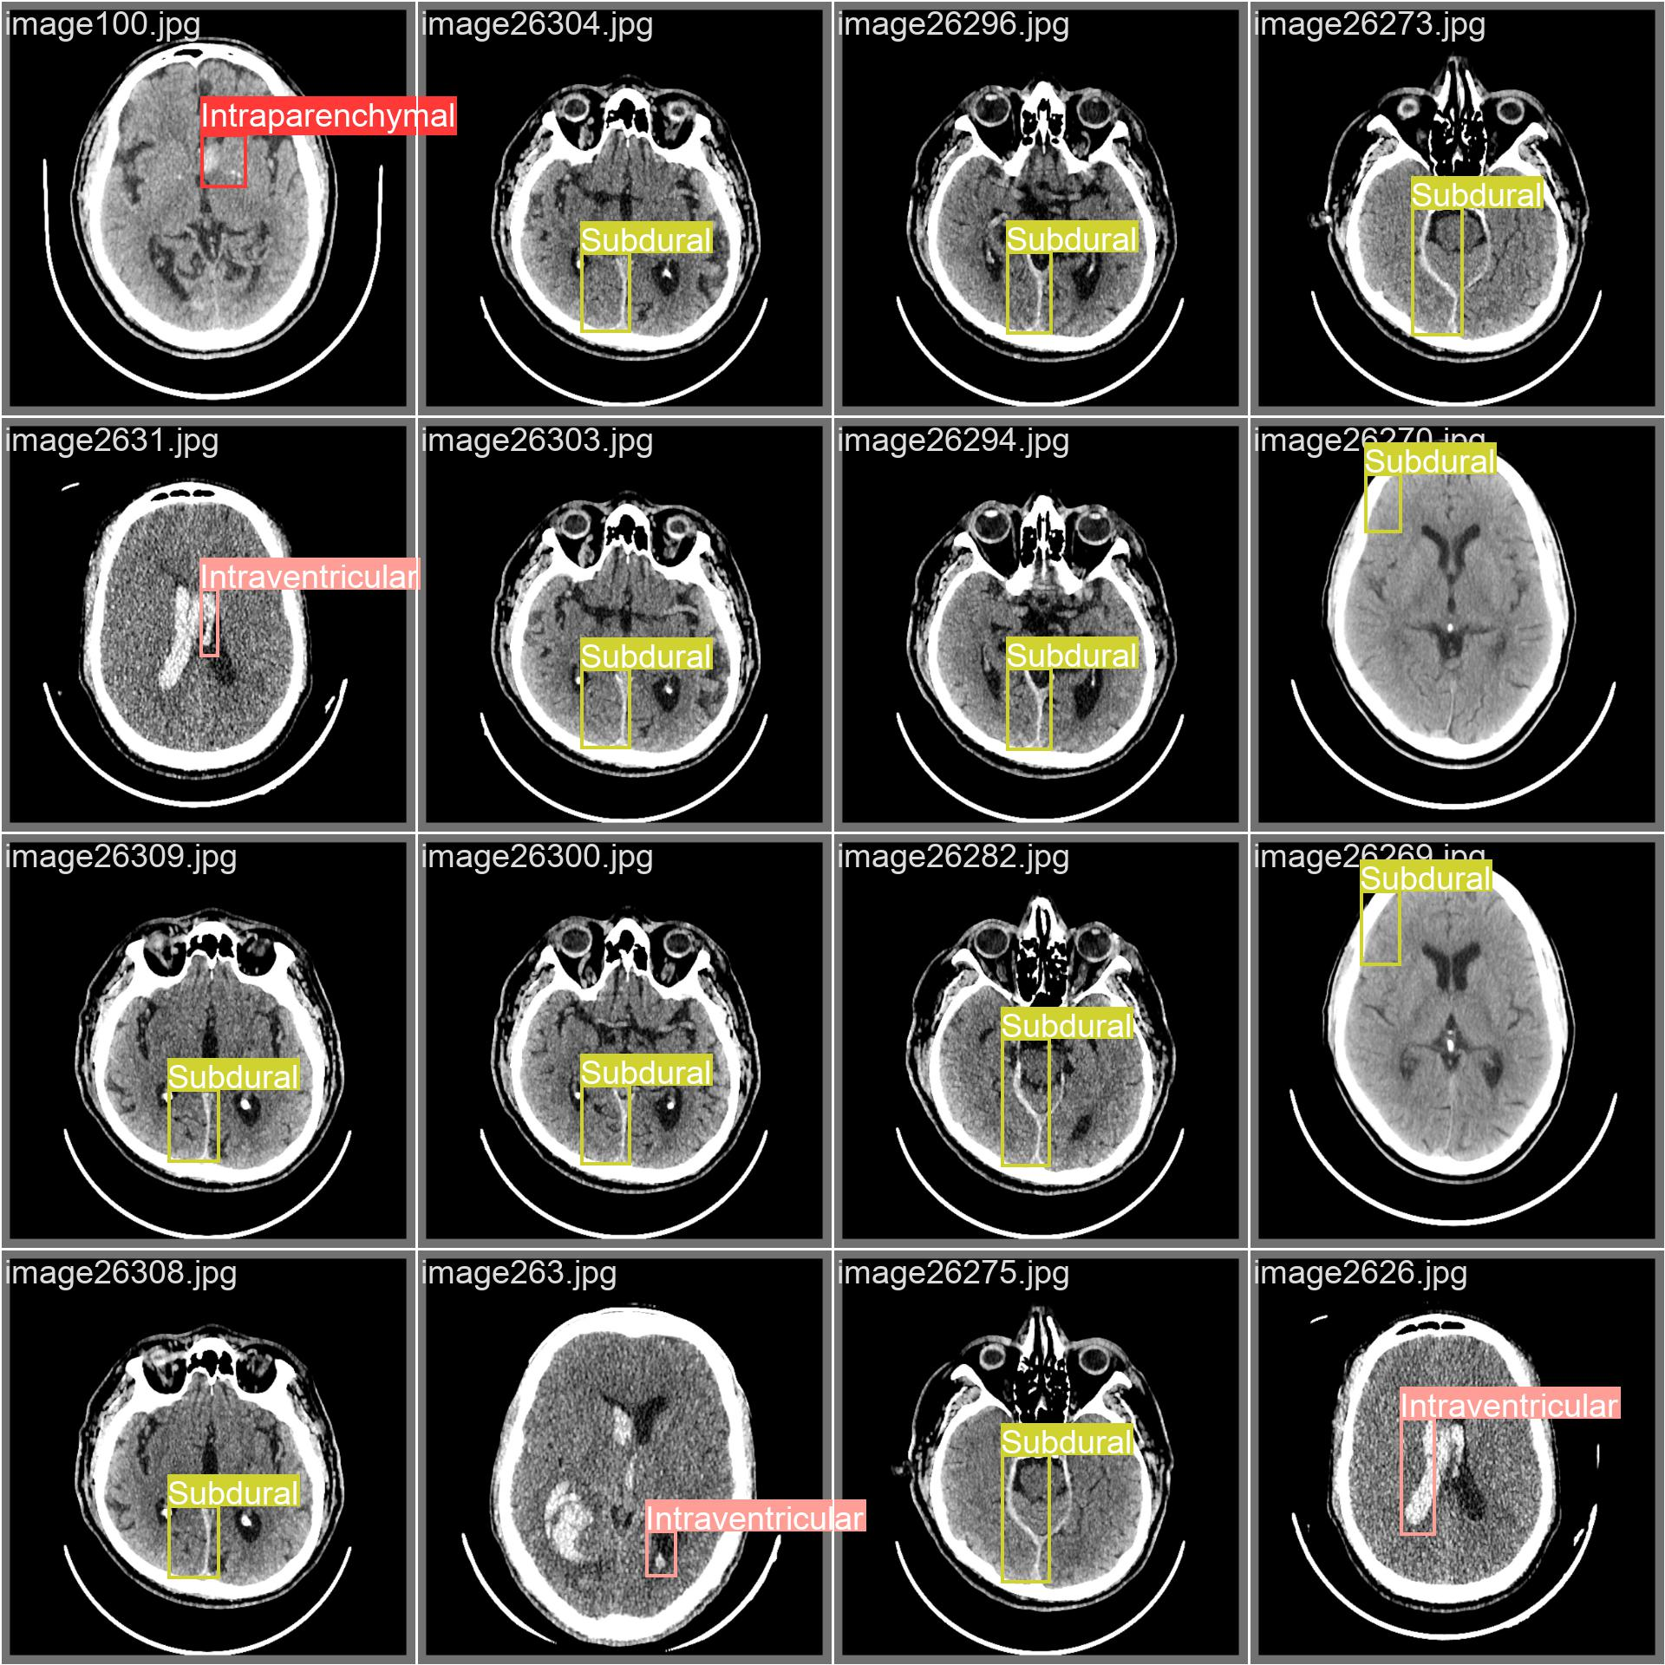
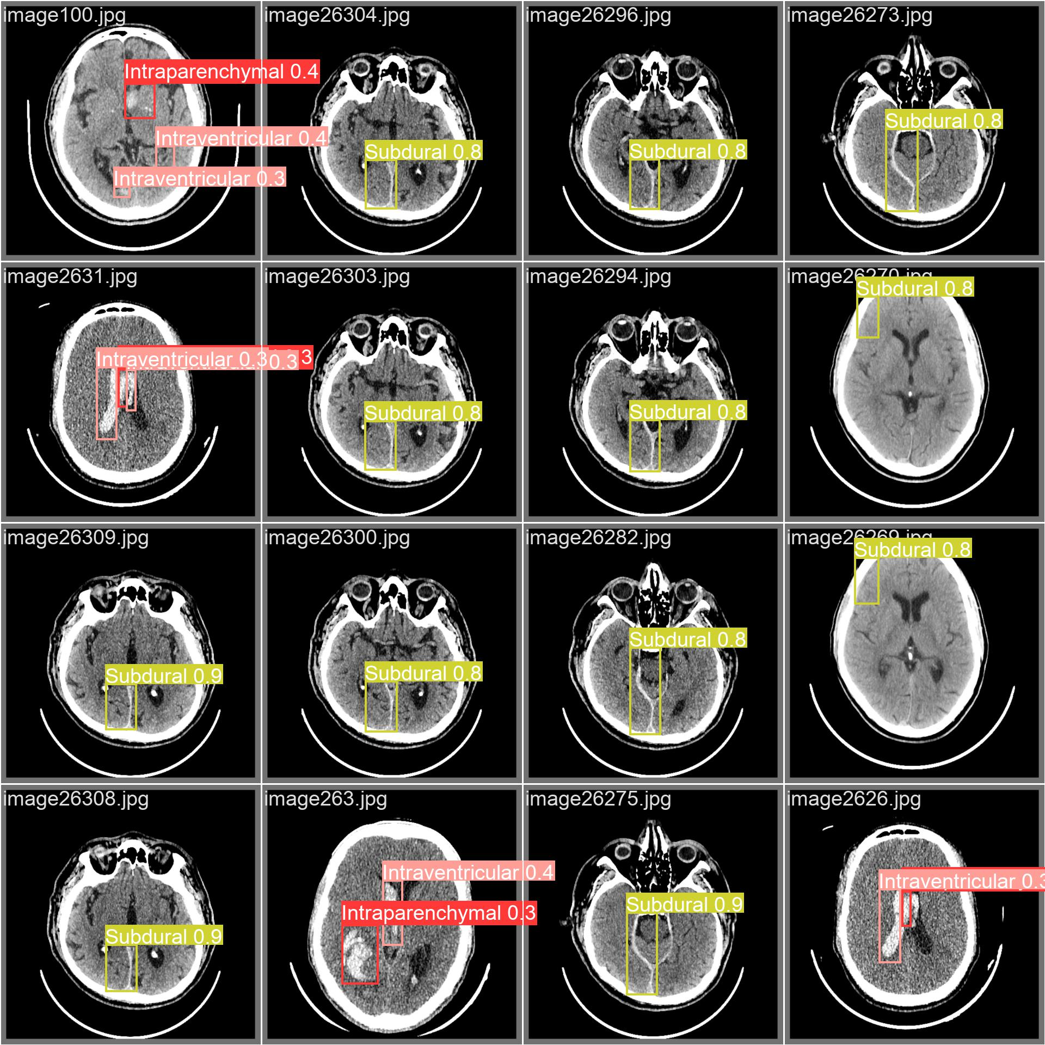
Validation batch
Predicted batch
Notes:
Left side, a validation batch
Right side, Predicted batch.
As I said earlier, signal image have more than one predicted labels

Slide 10
Thank You!

